Slide 1
Data Modelling: Deriving the Conceptual Data Model
420-D10 Database I – S07
References:
420-D20 N03

Slide 2
Objectives
Given business requirements generate a Conceptual Data Model
This is the first steps in the design phase of the data model

Slide 3
Conceptual Data Model
What is it for?
First step in constructing a data model
Can’t be implemented in a relational database management system
Clear and accurate visual representation of the business case
Comprises entities and relationships
Notes:
We’ll see later why we can’t implement a conceptual data model in a RDBMS (it’s all in the normalization and key/table definition)

Slide 4
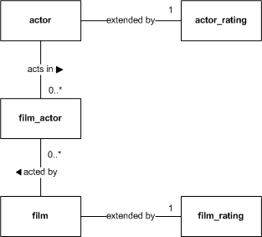
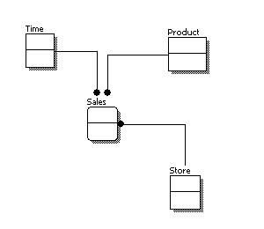
Sample
Notes:
Not necessarily the notation we will use, but an example of the kinds of information we want to convey in a Conceptual Data Model
Can you intuitively interpret the diagram?

Slide 5
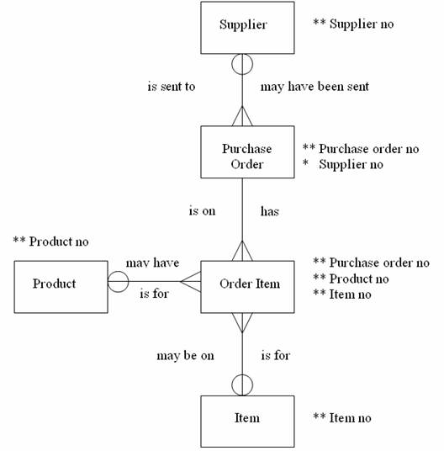
Sample
Notes:
Not necessarily the notation we will use, but an example of the kinds of information we want to convey in a Conceptual Data Model

Slide 6
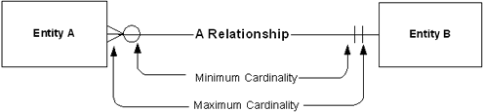
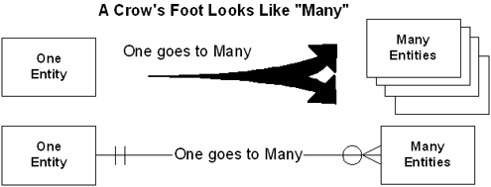
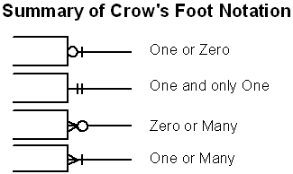
Crow’s foot notation
Notes:
Show them why it’s called Crow’s foot notation.
Source: http://tdan.com/crows-feet-are-best/7474
Class activity: See breakout activity D10_S07_A01

Slide 7
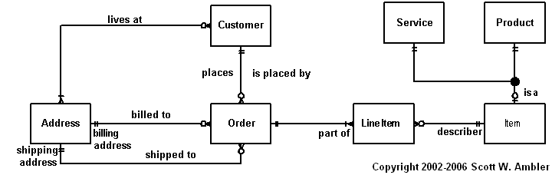
Sample
Notes:
Source: http://www.agiledata.org/essays/dataModeling101.html

Slide 8
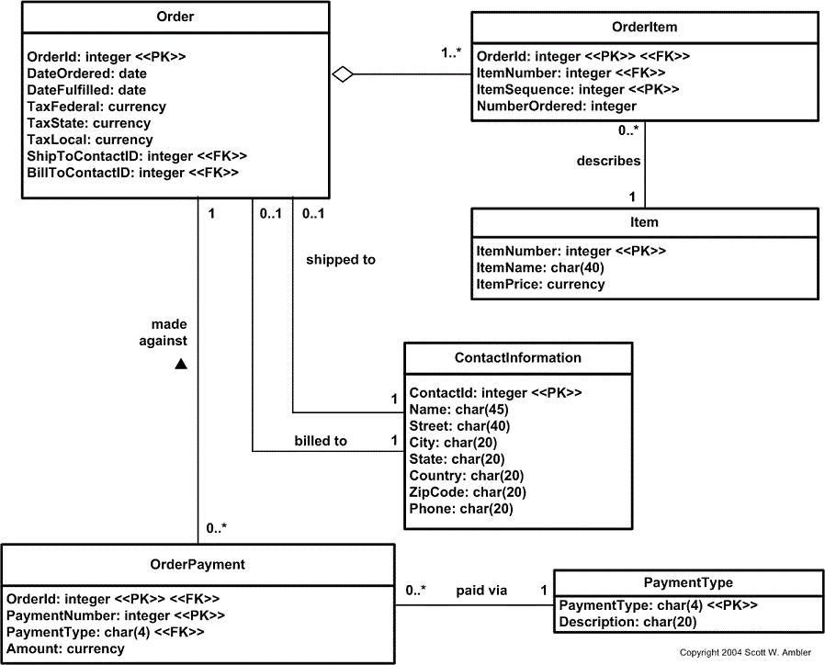
Next/Final Steps: Physical data model
Notes:
Note that the physical data model has:
Each entity has fully defined attributes and keys. (We’ll explain much of this later)

